Slide 1
LLM Agents
By: Tenneti Lekhya Sri Durga

Slide 2
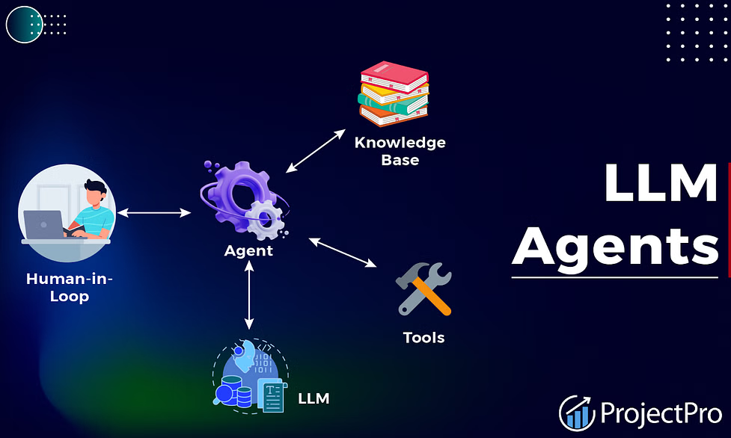
Agents
AI systems that utilize large language models (LLMs) as their core component to manage and direct the flow of actions.
So we can say that an agent communicates with the user and based on the users requirements it will respond by gathering information from various sources like APIs, databases and performs the task that is required.
It acts as the brain of the system, coordinating between the various subsystems (tools, memory, planning) to generate a response or perform an action.

Slide 3
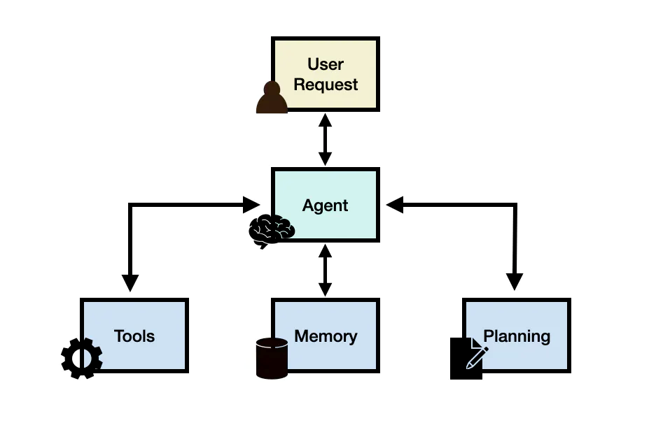
Architecture of an Agent
User Interaction:
The user initiates an interaction by making a request to the agent.
Example: The user asks, "Can you help me plan a trip to New York?“
Request Processing:
The agent receives the user request and begins processing it.
Planning:
The agent uses the planning component to break down the task into a sequence of actions and generates a plan or strategy to fulfill the request.
Planning with feedback:
The LLM agent engages in continuous planning based on feedback received during interactions with the user after providing a plan.
Planning without feedback:
The LLM agent operates without immediate feedback from the user. The plan solely depends on the initial query and available data sources.

Slide 4
Architecture of an Agent
Tool Utilization:
Based on the plan, the agent interacts with various tools to gather information or perform actions.
For example, the agent might use a flight booking tool to find available flights to New York.
Integrating Responses:
The agent gathers responses from the tools.
User Response:
The agent formulates a final response to the user, based on the integrated data.
It then communicates this response back to the user.
Example: "I found several flights to New York for your trip. Here are the options: [list of flights]. Would you like to proceed with booking one of them?"

Slide 5
Types of LLM Agents
Conversational Agents:
These agents are designed to engage in natural language conversations with users.
Ex: E-commerce Shopping Assistant
Task-Oriented Agents:
These agents are focused on performing specific tasks or completing predefined objectives. They interact with users to understand their needs and then execute actions to fulfill those needs.
Ex: Virtual Assistants
Creative Agents:
These agents are capable of generating original and creative content such as artwork, music, or writing. They may use LLMs to understand human preferences and artistic styles, enabling them to produce content that resonates with audiences.
Ex: ArtiGen
Collaborative Agents:
Collaborative agents work alongside humans to accomplish shared goals or tasks.
These help in assisting by decision-making, generating reports, or providing insights.
Ex:CoLabPro

Slide 6
Examples of LLM Agents
1) Financial Advisory Agent :
This agent helps users manage their finances, providing personalized advice on investments, budgeting, and financial planning.
Workflow:
User Request: "What's the best way to invest $10,000 given the current market conditions?"
Agent: The agent understands the user's financial goals and risk tolerance.
Planning: It determines the necessary steps: assess market conditions, review the user's portfolio, and recommend investment options.
Tool Utilization:
Uses a stock market API to get the latest market data.
Accesses a financial database to fetch information on different investment like stocks, bonds, mutual funds, etc.
Memory: Remembers the user's past investment preferences and financial goals.
Response Generation:
"Based on the current market conditions and your risk tolerance, I recommend diversifying your $10,000 investment into a mix of high-growth tech stocks, government bonds, and a mutual fund focused on sustainable energy."

Slide 7
Examples of LLM Agents
2) Travel Planning Agent :
This agent helps users plan their trips by suggesting destinations, booking flights and accommodations.
Workflow:
User Request: "I want to plan a two-week vacation in Europe. Can you help me with this?"
Agent: The agent gathers the user's preferences, such as budget, interests, and travel dates.
Planning: It breaks down the task into finding destinations, booking flights and accommodations, and planning daily activities.
Tool Utilization:
Uses flight booking APIs to find and book flights.
Accesses hotel booking APIs for accommodation options.
Memory: Stores the user's travel preferences and previous travel history to provide personalized recommendations.
Response Generation:
"For your two-week European vacation, I suggest starting in Paris, then traveling to Rome, and ending in Barcelona. Here are your flight and hotel options, along with a detailed plan for each city."

Slide 8
Examples of LLM Agents
3) Educational Tutoring Agent
This agent assists students with learning by providing explanations, practice problems, and feedback on various subjects.
Workflow:
User Request: "Can you help me understand the concept of photosynthesis?"
Agent: The agent recognizes the subject and the specific concept the user needs help with.
Planning: It identifies key subtopics to be covered based on the topic.
Tool Utilization:
Accesses educational resources and databases to provide accurate information and also to provide proper diagrams.
Memory: Tracks the student's progress and areas where they need more practice.
Response Generation:
"Sure! Photosynthesis is the process by which green plants convert sunlight into chemical energy. Here's a detailed explanation along with a diagram: [detailed explanation and diagram]. Would you like to try some practice questions to test your understanding?"

Slide 9
Key Learning and Takeaways
WEEK 1:
Gained a basic knowledge on python programming language.
Learnt about different libraries used that is Numpy, pandas.
Also gained basic knowledge of what an LLM is.
WEEK 2:
Learnt about what an agent is and how the agents work.
Got to know about multiple applications where these agents are used and how they are used.
Learnt about the architecture of an agent.
WEEK 3:
Selected a particular application in which we wanted to create an agent.
I have selected the travelling platform so my task was to create a travel planning agent.
So for this I have created a design so that I would get a proper structure of what has to be exactly done in my project.
WEEK 4:
I started working on the implementation of my agent
I learnt about what an API is, how to integrate an API, how to test an API and also how to integrate LLM models into our code.

